Slide 1

Day 2
8/11 or 8/12

Slide 2
Check answers to:
Investigate the teacher
Textbook scavenger hunt
Safety contract

Slide 3
Setup Science Notebook
The science picture you colored should go in the front cover of your Science Notebook
You will need to divide your notebook into 4 sections. They should be labeled as follows:
1st 9 weeks
2nd 9 weeks
3rd 9 weeks
4th 9 weeks
Each section needs one piece of notebook paper titled SNB TOC (then put the appropriate 9weeks)
Your papers should be in the same order as my SNB TOC on the board.

Slide 4
Data in TEAMS and Student questionnaire
Go to TEAMS and you will see an assignment titled Data folder. Open that assignment and practice entering data as shown by the teacher.
The second assignment in TEAMS is the student questionnaire. Please answer these questions in complete sentences.

Slide 5
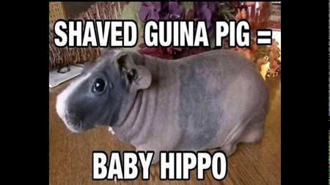
Pretest Friday!!!! Bring your laptop if you have one.

